Slide 1
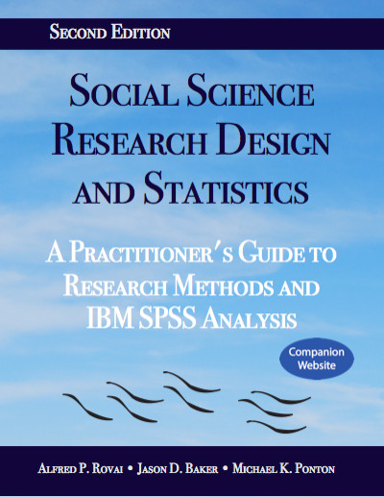
Social Science Research Design and Statistics, 2/e
Alfred P. Rovai, Jason D. Baker, and Michael K. Ponton
Spearman Rank Order Correlation Test
PowerPoint Prepared by
Alfred P. Rovai
IBM® SPSS® Screen Prints Courtesy of International Business Machines Corporation,
© International Business Machines Corporation.

Slide 2
Uses of the Spearman Rank Order Correlation Test
Determine the monotonic strength and direction of the relationship between two ranked variables (i.e., ordinal scale variables).
Test the hypothesis that there is no monotonic relationship between two variables in the population (i.e., zero correlation in the population; ρ = 0).
This test can be used for any type of data, except categories that cannot be ordered. The Spearman rank order correlation coefficient (r_{s}) can be used instead of Pearson r if Pearson r parametric assumptions cannot be met.
The absolute value of r_{s} can be interpreted as follows:
  Little if any relationship < .30
  Low relationship = .30 to < .50
  Moderate relationship = .50 to < .70
  High relationship = .70 to < .90
  Very high relationship = .90 and above

Slide 3
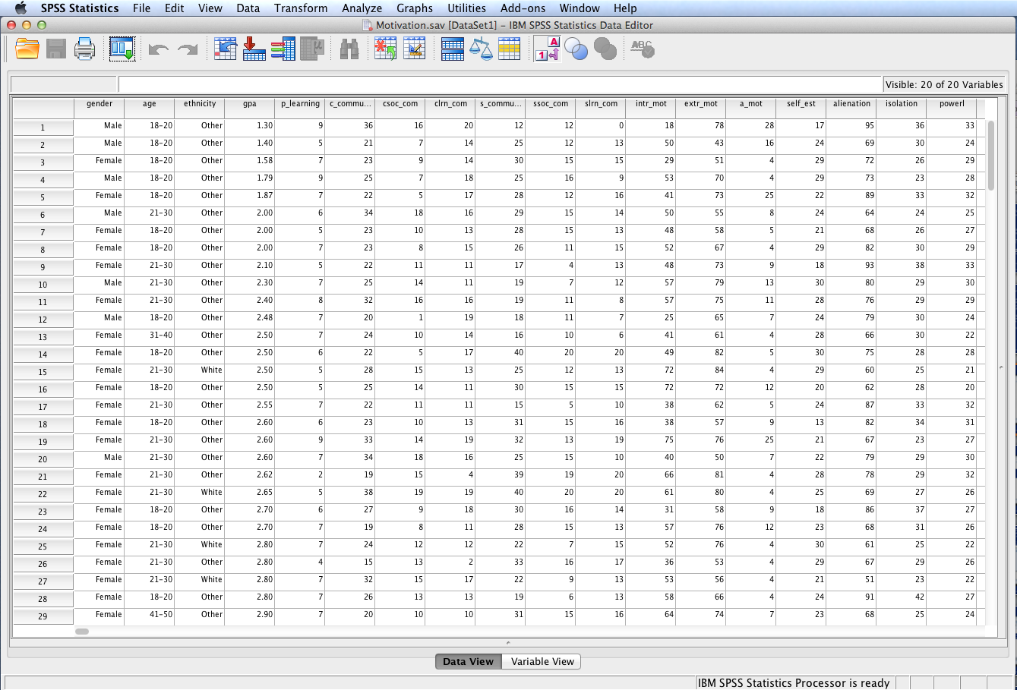
Open the dataset Motivation.sav.
File available at http://www.watertreepress.com/stats

Slide 4
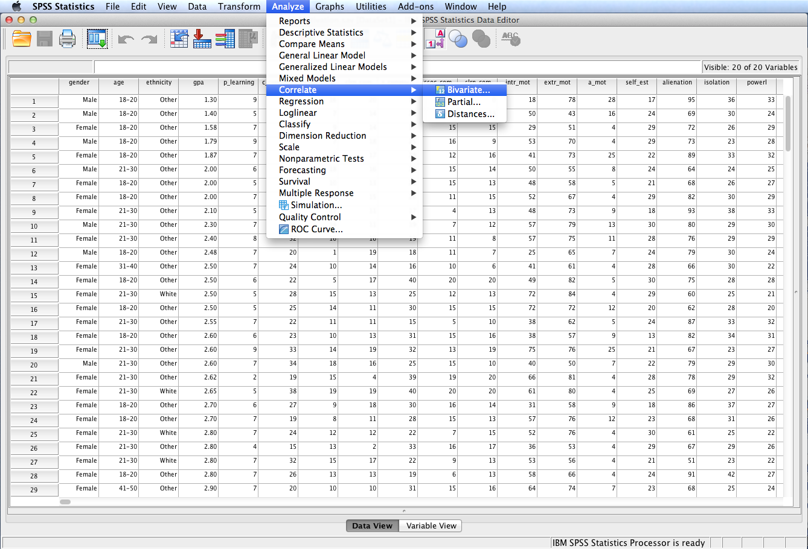
Follow the menu as indicated.

Slide 5
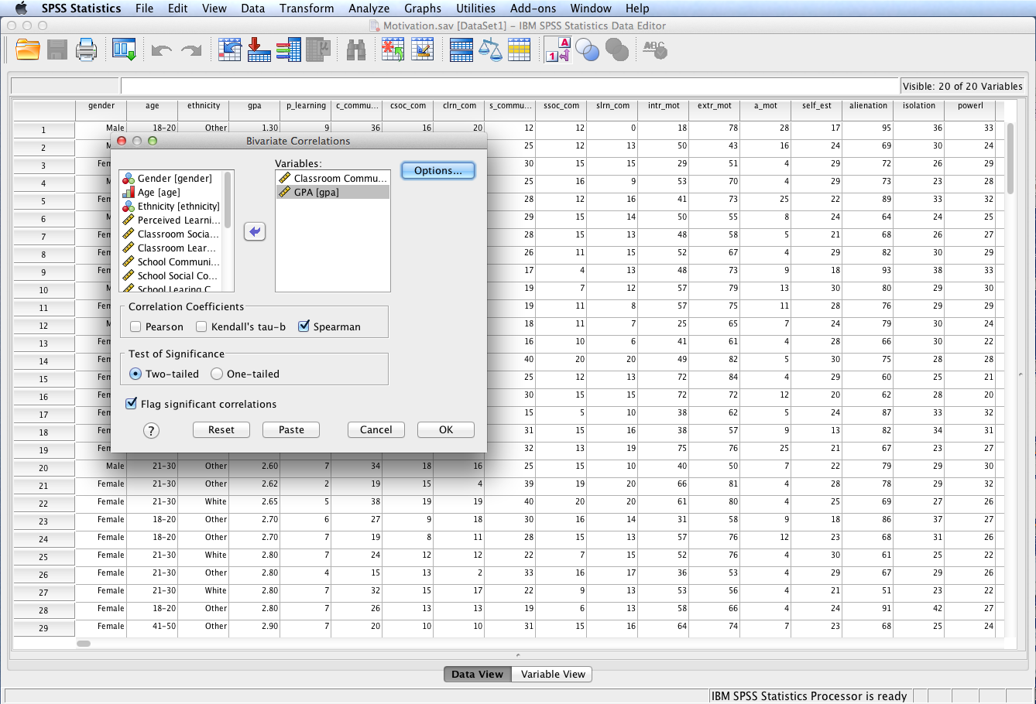
In this example, we will test the following null hypothesis:
H_{o}: There is no relationship between sense of classroom community and grade point average, r_{s} = 0.
Select and move Classroom Community and
GPA to the Variables: box. Check Spearman as the correlation coefficient. Click OK.

Slide 6
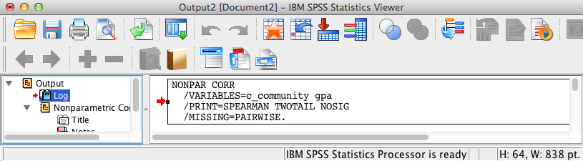
SPSS Output
The contents of the SPSS Log is the first output entry. The Log reflects the syntax used by SPSS to generate the Nonparametric Correlations output.

Slide 7
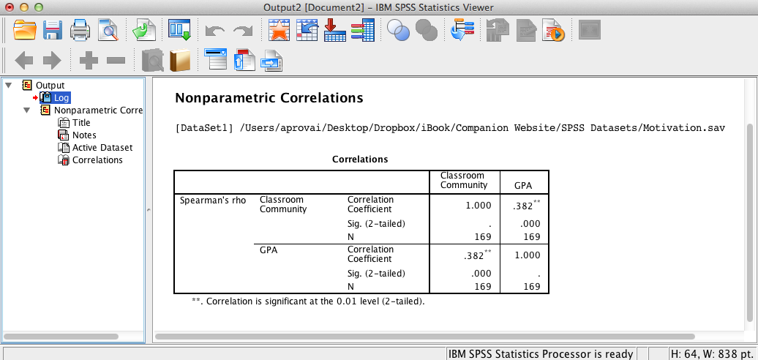
SPSS Output
The above SPSS output displays a significant relationship, r_{s} = .38, p < .001, between sense of classroom community and grade point average since the approximate significance level <= .05 (the assumed à priori significance level).

Slide 8
Spearman Rank Order Correlation Test Results Summary
H₀: There is no relationship between sense of classroom community and grade point average, r_{s} = 0. The Spearman rank order correlation test was significant, , r_{s} = .38, p < .001. Consequently there is sufficient evidence to reject the null hypothesis.
These results provide evidence of a low but significant direct relationship between classroom community and GPA.
The coefficient of determination is r_{s}² = .14, which indicates that sense of classroom community accounted for 14 percent of the variance in grade point average, or that grade point average accounted for 14 percent of the variance in sense of classroom community, or that they share 14 percent of variance in common.

Slide 9
End of Presentation

